Slide 1
Most Valued Data Science Skills
Andreina Arias, Jiaxin Zheng, Leslie Tavarez, Nakesha Fray, and Yanyi Li

Slide 2






Our Team's Toolkit for Success

Slide 3
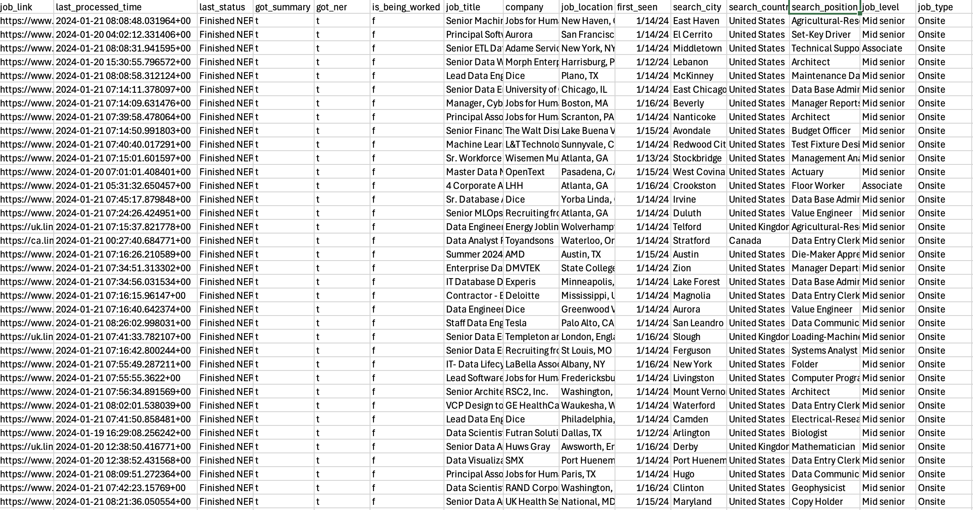
Overview of Our Dataset
This dataset presents an extensive compilation of job postings related to data science sourced from LinkedIn.
It encompasses information on job titles, companies, locations, search criteria, and additional relevant details.
Data Link

Slide 4
Research Question: Which are the most valued data science skills?

Slide 5
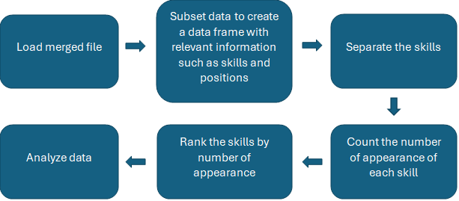

Slide 6
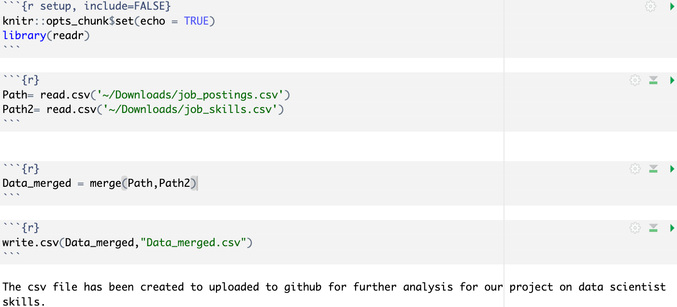
Step 1: Importing and Merging Datasets in RStudio
To find the most valued data scientist skills we used a data set on linkedin job posting from kaggle. The data set for job postings and job skills were in separate csv file which needed to be merged for the purpose of our project. To merge the 'readr' library was loaded into R to read the two csv file, then assigned them to their own variable. The 'merge' function was used to merge the two variables and then the 'write.csv' function was used to create the single csv from the merged csv files. The CSV file was uploaded to GitHub for further usage.
Data source downloaded from: Data Link

Slide 7
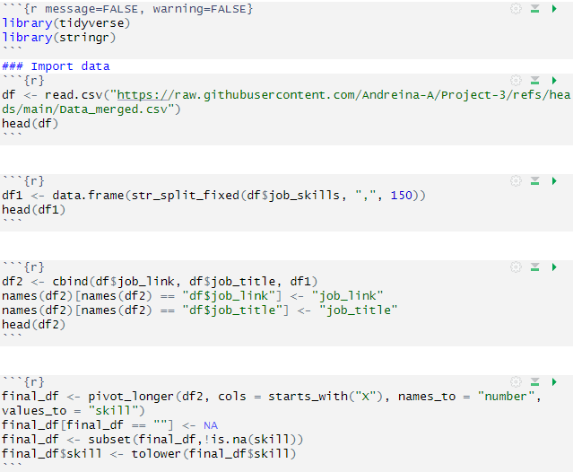
Step 2: Data Preparation and Cleaning
Libraries 'tidyverse' and 'stringr' were loaded for analyzing and tidying the data.
The data set was loaded from "raw.githubusercontent.com/Andreina-A/Project-3/refs/heads/main/Data_merged.csv" using 'read.csv' function.
The skill in the dataset were separated by commas to create a data frame the skills the str_split_fixed() function was used. The cbind function was used to extract the job links and job titles from the original data frame into the created data frame.
To have a data frame with the skills we created a final data frame by gather all the skills into one column using pivot_longer, removed NA data along the way and made all skills into lowercase.

Slide 8
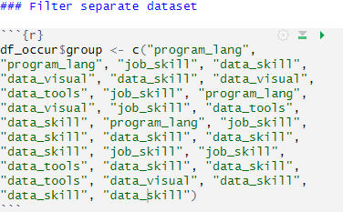
Step 3A: Tidying Our Data for Analysis
A group was assigned to each skill, making them easier to subset in the next part. The five groups designated are as follows:
Programming Languages
Data Tools
Data Visualization Tools
Job Skills
Data Skills

Slide 9
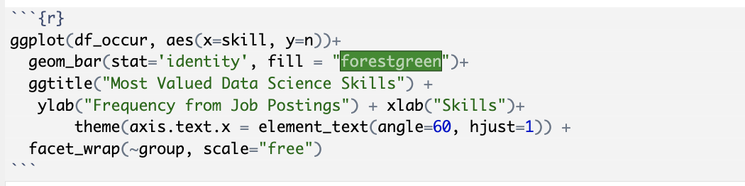
Step 4a: Data Visualization
Using the ggplot function along with the facet_wrap function bar plots were made from the data.
The different skill groups were plotted into separate bar plots. The groups were data skills, data tools, data visual, job skill, and programming language.

Slide 10
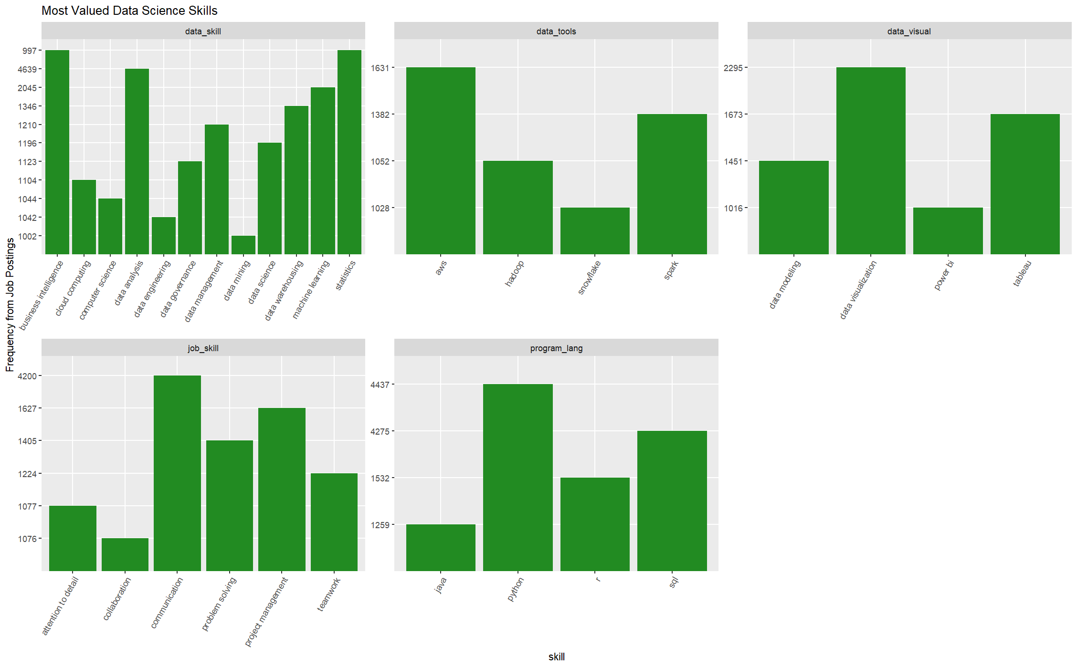
Conclusion: Plotting the results

Slide 11
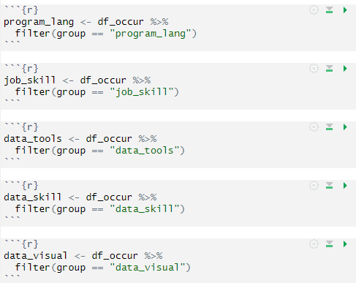
Step 3B: Tidying Our Data for Analysis
Then we used filter to subset the skills to each group so we can plot each group separately.
Since there are five different groups, we created five subsets.

Slide 12
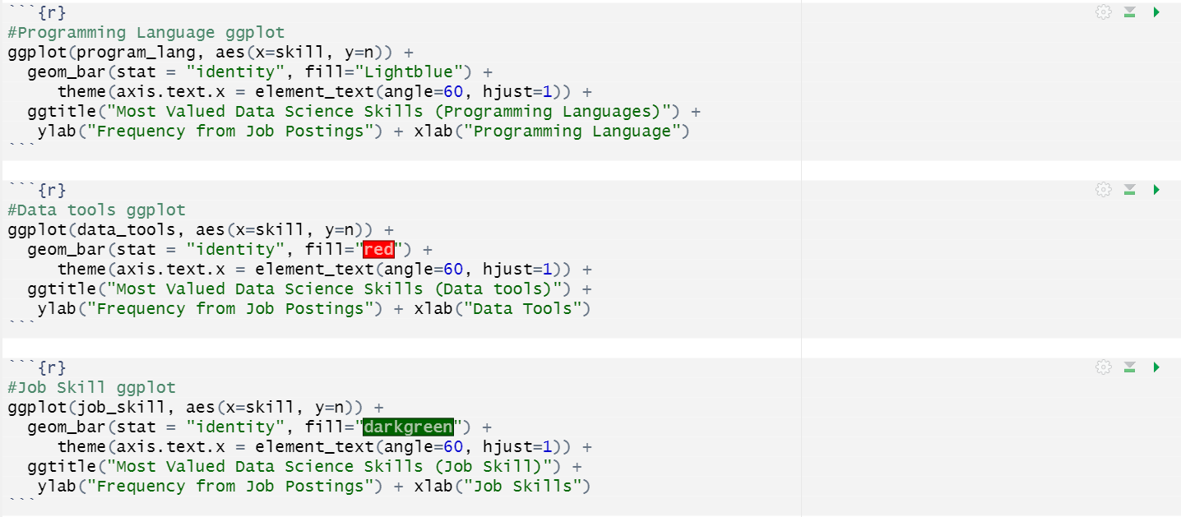
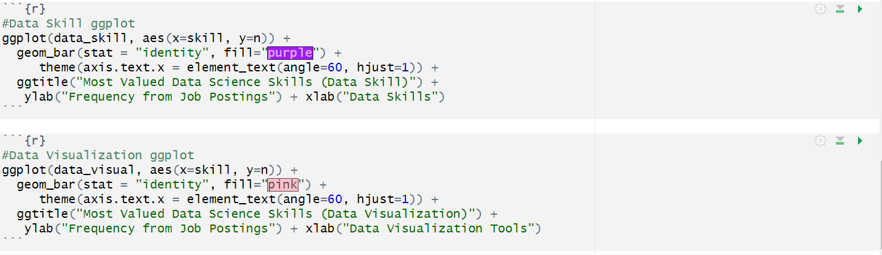
Step 4b: Exploring Data Through Visualization
Explore and visualize different categories of data science skills by using ggplot2
Identifying the most valued skills in each category
Programming Languages
Data Tools
Data Visualization Tools
Job Skills
Data Skills

Slide 13
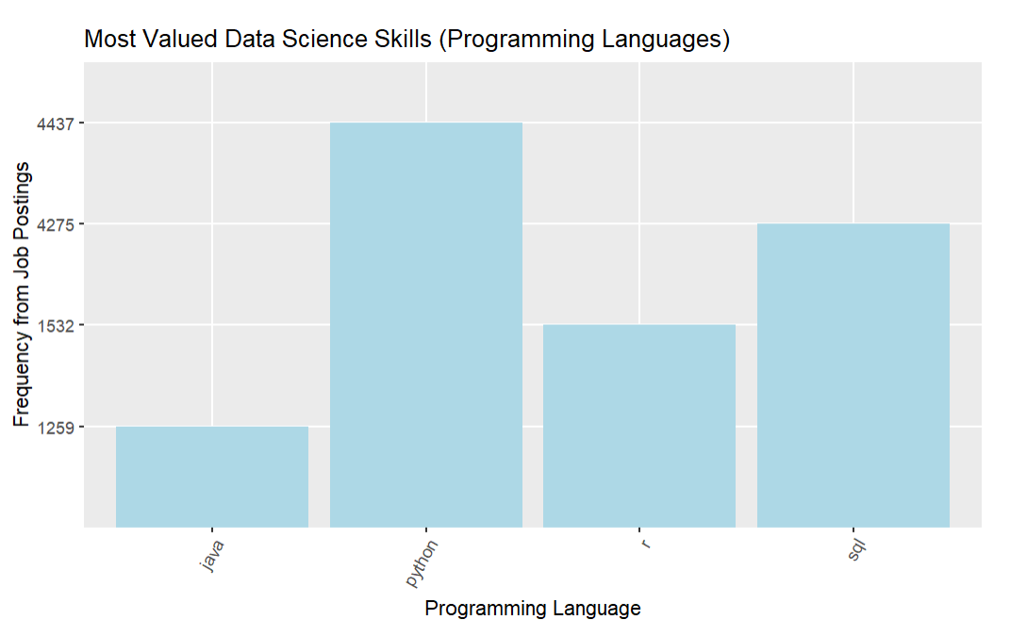
Conclusion: Programming Languages

Slide 14
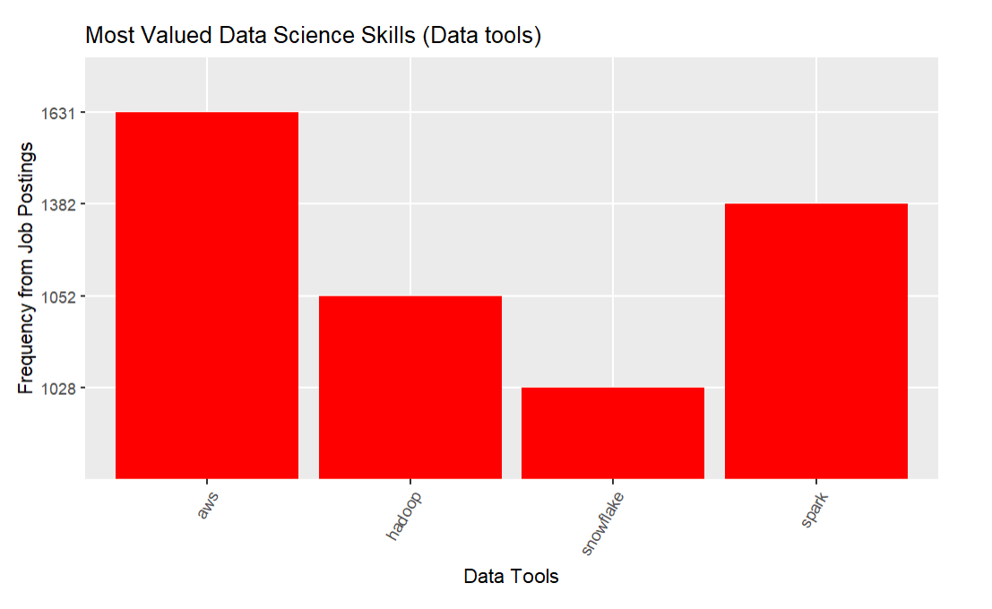
Conclusion: Data Tools

Slide 15
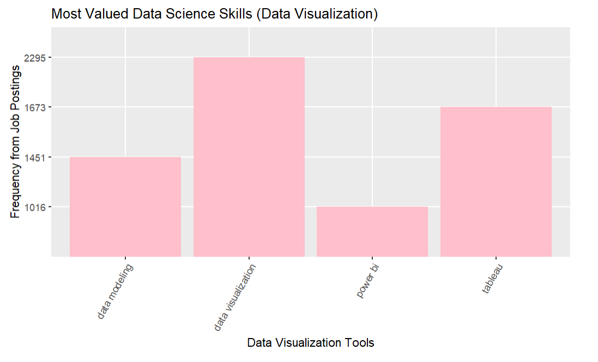
Conclusion: Data Visualization

Slide 16
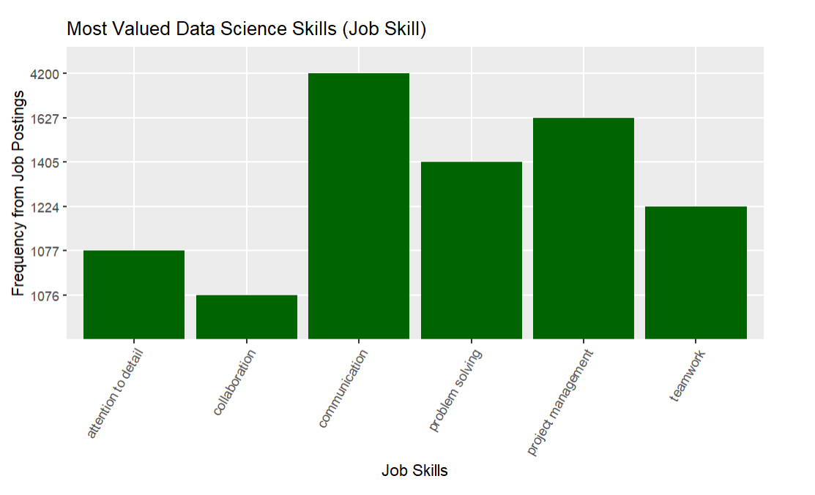
Conclusion: Job Skills

Slide 17
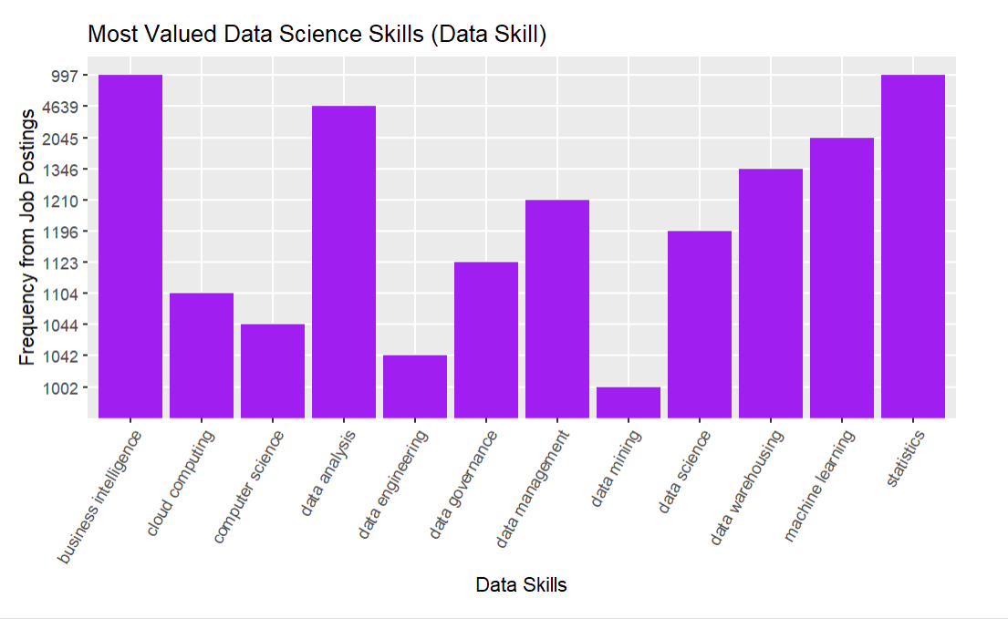
Conclusion: Data Skill

Slide 18
Future Research Directions: What We Can Explore Next
Analyze In-Demand Job Titles: Investigate which job titles are most sought after for data science professionals.
Identify Leading Employers: Find out which companies are hiring the most data science talent.
Explore Job Location Trends: Determine the most popular locations for data science positions.
Examine Job Level vs. Required Skills: Investigate how required skills vary by job level in data science roles.

Slide 19
Thank you for listening! Questions?

